Slide 1
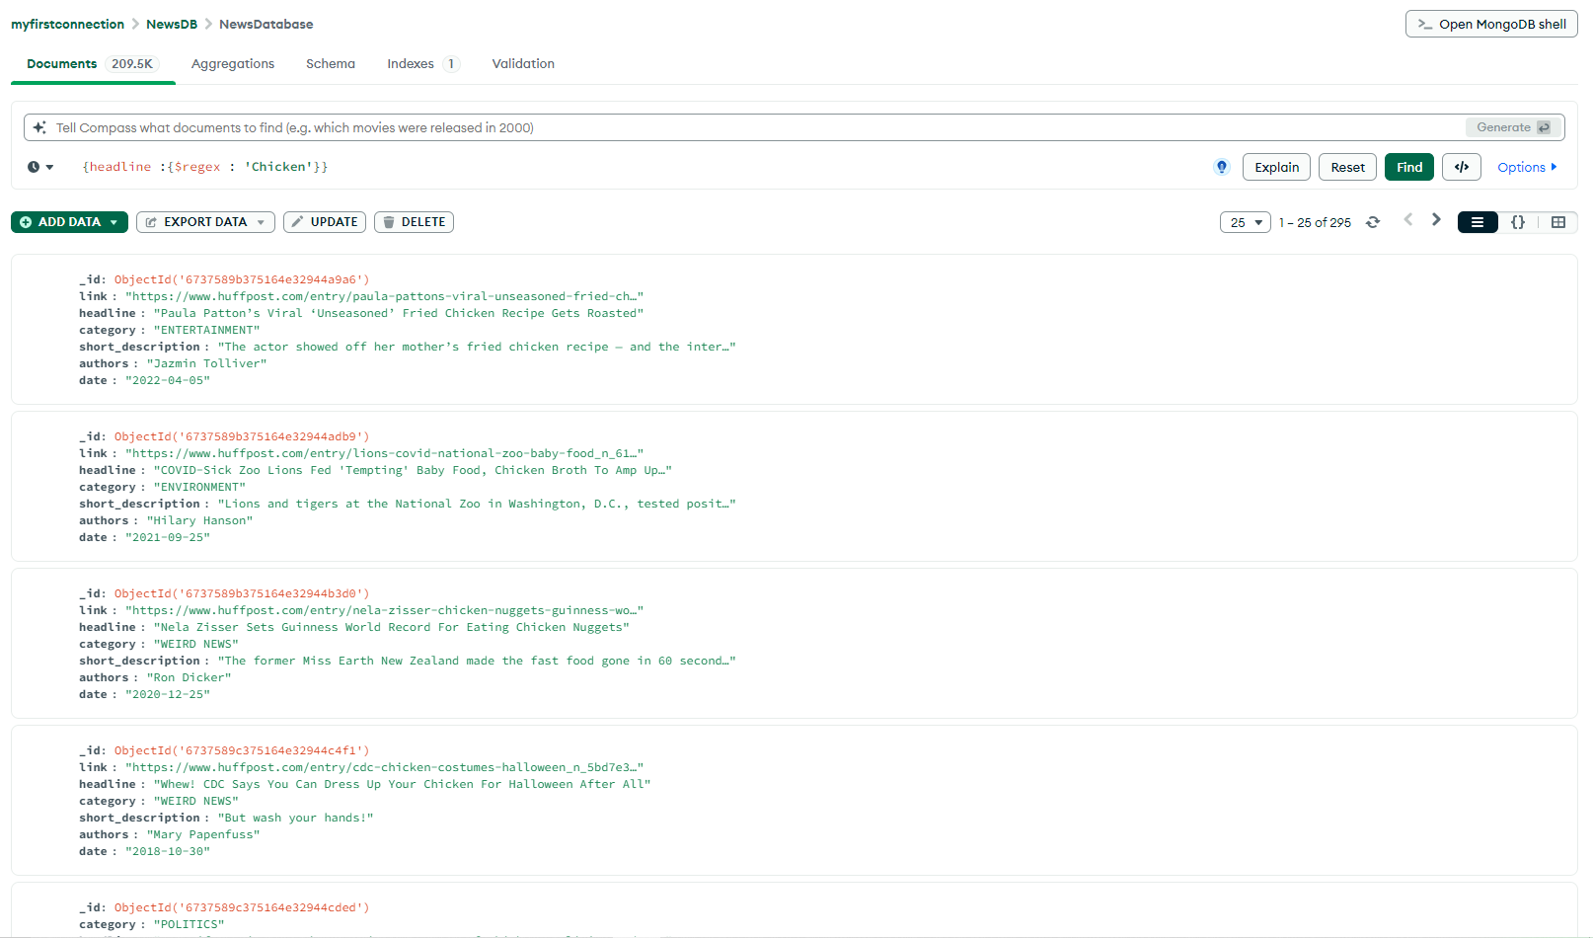
MongoDB Portfolio Project
An exploration of the tools

Slide 2
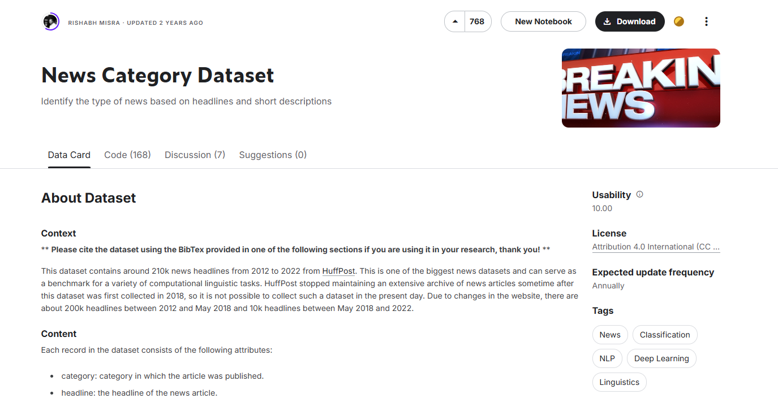
Project Aims
MongoDB (and its desktop application ‘MongoDB Compass’) is a powerful tool to have when navigating, searching and extracting insights from NOSQL databases. In this project, I will be performing EDA (Exploratory Data Analysis) on an unstructured database consisting of hundreds of thousands of news articles in an effort to better understand the potential the software has to help with data analysis.
The database I used can be found on Kaggle at:
https://www.kaggle.com/datasets/rmisra/news-category-dataset

Slide 3
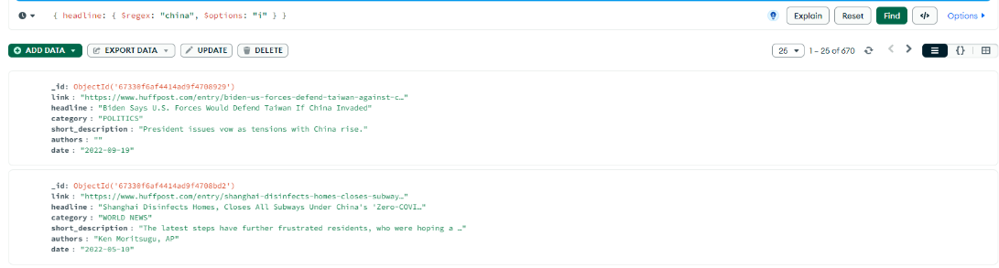
My first query
After importing the database into MongoDB compass, I ran this query to have a look at all of the news headlines that had ‘china’ in them at any point. I was able to find out that there were 670 occurrences in the database, though I also made an interesting discovery that could become problematic if I did not take steps to sort it…

Slide 4
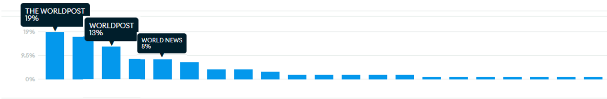
Merging similar results
In the ‘Category’ field, I learned that there were multiple definitions for world news articles, such as ‘THE WORLDPOST’, ‘WORLD POST’ and ‘WORLD NEWS’, that would be important to congregate under a single value to streamline my queries and avoid missing pieces of data that would contribute to my findings.

Slide 5

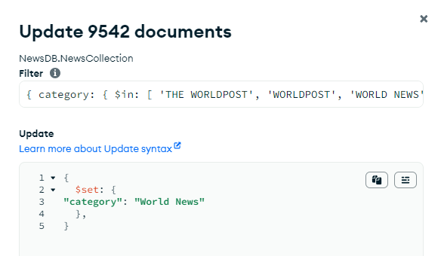
Merging similar results
To start, I used this query to select all documents with the previously mentioned categories.
Then, after clicking on the update tab, I could input this code to unite all three values under a single value. Once I performed the same query (modified to also check the count of these articles) afterwards, I can see that 46% of all headlines containing ‘china’ came from ‘World News’, and that there were 670 records in total out of this database consisting of over 200k documents. Performing this alteration would make things much easier to analyse from here on out, in Compass or not.

Slide 6
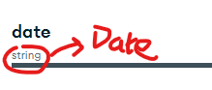
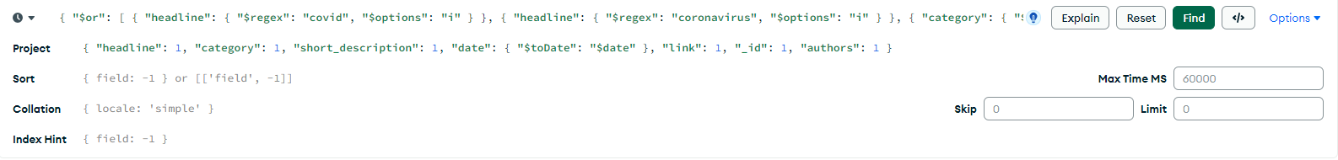
Another Query
My next query will look at the frequency of articles including the word ‘covid’ or ‘coronavirus’ and how they appear across the time frame. An expanded version of the query code can be seen to the right – we will be looking at the results in the data section of the schema tab.
However, further inspection revealed that the contents of the ‘date’ field were of a string format instead of a date format, which would need to be converted in order to perform this analysis. I can do this either through a permanent conversion or run my query with an aggregation pipeline to convert the dates of the documents I query into the correct format. For this exercise, I will perform this temporarily through my pipeline.

Slide 7
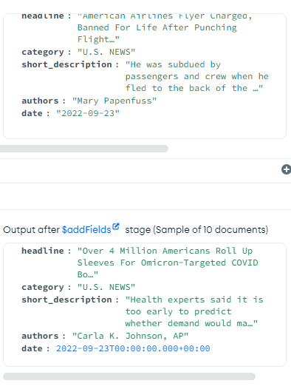
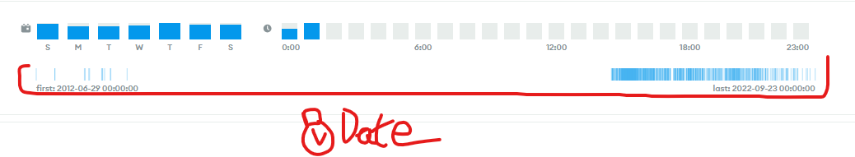

Another Query
The result of this conversion is a much different view in the schema panel for the date category, where each article is placed in a timeline to create something similar to what looks like a heatmap. Interestingly, news articles about coronaviruses were dotted around in the early 2010’s before petering off until 2020, where occurrences exploded before slowly waning again as the years continued.

Slide 8
What I’d try next
As I continue exploring the tools a data analyst can have at their disposal, I would like to try to edit databases within MongoDB on a large scale on a permanent basis. My attempts at changing the data string field into a date format permanently didn’t work as planned, and I ended up modifying the field in a completely different way that forced me to start over! Learning of a way to be able to make these changes safely (like with a sort of version control) could allow me to experiment more thoroughly with editing entire databases.

